Slide 1

Identifying critical higher‑order interactions in complex networks
Mehmet Emin Aktas,
Thu Nguyen, Sidra Jawaid ,Rakin Riza & EsraAkbas

Slide 2
Introduction
The critical interactions in networks play critical roles in diffusion and primarily affect network structure and functions. While interactions can occur between two nodes as pairwise interactions, i.e., edges, they can also occur between three or more nodes, which are described as higher-order interactions.
To identify higher order interactions ,this paper proposes two new novel laplacians to generalize graph centrality measures of higher order interactions in complex networks.
This paper uses two methods to measure the effectiveness of these centrality measures using size of gaint component and SIR.

Slide 3
Methods to Identify critical nodes & Edges.
Degree of nodes such as degree centrality and H-index , some use paths in networks such as closeness centrality and betweenness centrality.
Some people use Node deletion to identify critical nodes.
The authors use the betweenness centrality of edges to detect critical edges. In other words, they assume that edges connecting two connected components are important. There are also other studies that use flow/reachability, bridgeness, neighbors, and clique degrees to measure the edge importance.

Slide 4
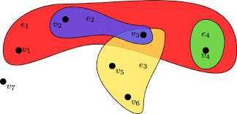
Higher order Interactions
In the real-world Interactions can occur not only between two but also three or more nodes, which are described as higher order interactions.
Hypergraphs are used to model higher-order interactions in complex systems where entities are represented as nodes, and higher-order interactions among them are represented as hyperedges.

Slide 5
Limitations:
In one paper, They proposed a problem for finding the most and least influential cliques of fixed size in graphs based on group degree, group closeness, and group betweenness centralities.
In other paper, They use the group betweenness centrality to find the most influential group of nodes and a general group of graph elements (containing nodes and edges) of a fixed size.
In the other paper, they find the most influential group of nodes using the group closeness centrality and further, identify a subset of critical edges whose removal maximally degrades the closeness centrality of those vertices.
Detect the smallest set of initially influenced nodes in hypergraphs such that all the users are influenced at the end of the influence diffusion process.
Notes:
These only detect the most critical group of fixed size and unable to compare groups of any size.
All these studies were majorly focusing on the nodes rather than higher order interactions.

Slide 6
Handling diffusion models in hypergraphs via Laplacians is not an easy task, as they have more than two vertices and edge and edge incidence and vertex adjacency are set-valued in hypergraphs.
Some studies study random walks on hypergraphs for modeling diffusion, but much of them only consider uniform hypergraphs.
There is another solution provided by Horak et al, defines the simplicial Laplacians for the hypergraphs with the simplicial complex structure, i.e., subsets of hyperedges are also hyperedges.
Notes:
*To handle these issues researches tried to limit their attention to uniform hypergraphs where they have same cardinality.
A simplicial complex structure composed of points , line segments ,triangles.
There are three problems with s defined only for hypergraphs with the simplicial complex structure, Laplacian models the diffusion only through the hyperedges of sizes k − 1 and/or k + 1 and we need to assume that information only diffuses between fixed size hyperedges.

Slide 7
Addressing these Limitations:
Two new hypergraph Laplacians based on the diffusion framework that allow us to find the influential higher-order interactions in a hypergraph of any size.
one is based on diffusion between fixed size hyperedges and other one is based on diffusion between all hyperedges.
Four graph centrality measures, namely DFF (HDFF), degree (HDeg), betweenness (HBtw), and closeness (HCls), to hypergraphs and rank higher-order interactions based on these measures.
We further compare the first order interactions with the higher order intreactions using SIR and a by size of gaint component
Notes:
diffusion Fréchet function

Slide 8
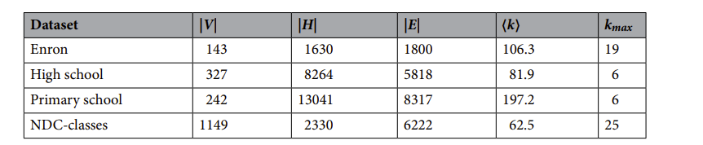
Data Description:
Four datasets have been used here :
Enron: vertex-email address of staff member, hyperedge:all the recipients
High school : vertex: student ,hyperedge: a set of students in close contact with each other
Primary school: vertex: a student/teacher ,hyperedge: set of them close contact with each other
NDC-class: vertex: pharmaceutical class label ,hyperedge: drug with many class labels.

Slide 9
Evaluation metrics:
Size of giant component :
In this method, we rank the interactions from the most influential to least influential for each centrality.
We remove the interactions from network one by one starting from the most to least, and calculate the size of the giant component.
A more effective method will have faster fall in the graph and area under under curve should be smaller.

Slide 10
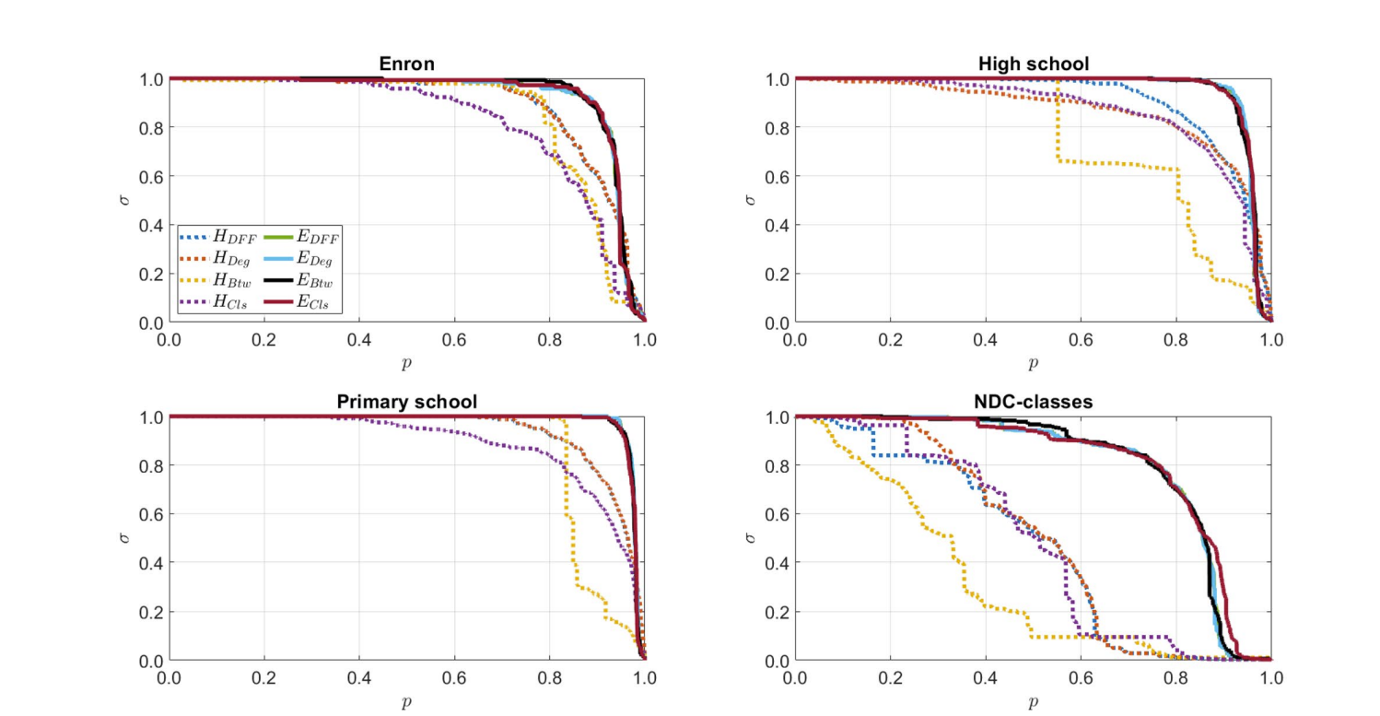
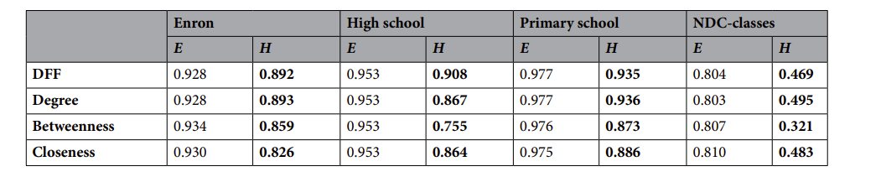

Slide 11

SIR(Susceptible-Infected-Recovered Model)
Each node is classified as a Susceptible (S), Infected (I), or Recovered (R) at any given moment.
Initially we assign selected node as Infected, and other nodes are susceptible and it can affect with probability µ. And can be recovered with probability β and can not be infected again.
The diffusion level is measured by the total number of nodes that were infected, including nodes that recovered, after all propagations are complete. A greater number means a greater spreading ability and a greater influence on diffusion.

Slide 12

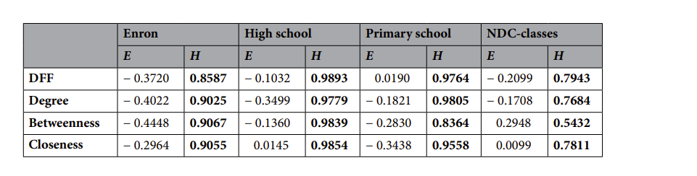
The diffusion index of removing a certain node on fraction of hyperedges is calculated and then to compute the higher order interactions we calculate the average.
The larger diffusion index means the removed interactions are important.
In this experiment we first rank the first-order and higher-order interactions from the most influential to the least for each centrality and divide them into 50 equal parts.
Remove one part we and calculate the diffusion index(R).
Notes:
F1 and F2 are results of the original network and the network after removing p of higher-order interactions respectively
To check the correspondence between them we calculate spearmen correlation coefficient.

Slide 13
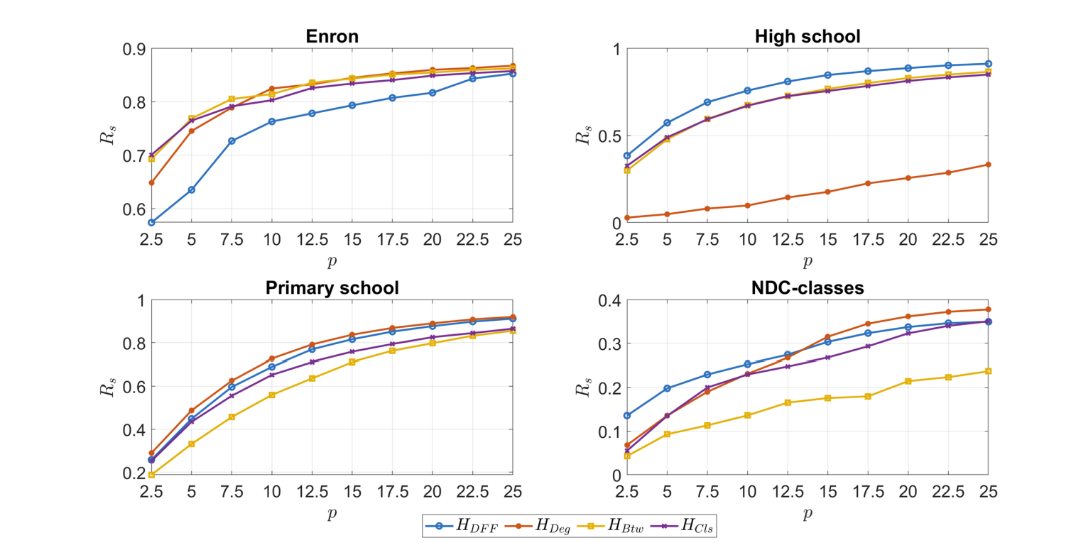
Notes:
To measure the effectiveness of centrality measures, the infection rate is fixed and by varying ratio of hyperedges we find the diffusion index.

Slide 14
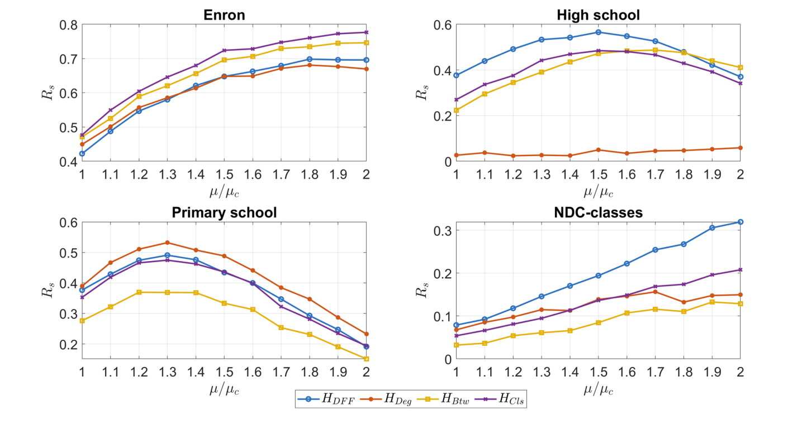
Notes:
Here the ratio of hyperedges removed is fixed at 5%, and vary the infection rate. for High school and Primary school, Rs initially increases but then decreases. Tis is due to the network structure of these two datasets. Tese networks have a large number of hyperedges per vertex comparing the other networks. As a result, the change in the weights is larger than the other networks when 5% of hyperedges are removed and the critical value of the function of the diference between the infection rates before removing and afer removing is smaller

Slide 15
Two new Laplacians
Graph Laplacian

